Slide 1

Building and Implementing a Generative AI Chatbot for IoT
Presented By
Sirajudeen J
(910622301048)

Slide 2
Abstract
Develop and deploy a Generative AI Chatbot tailored for IoT applications in collaboration with PiltiSmart Technology Solutions.
Enhance user interactions within IoT ecosystems by providing real-time assistance and seamless communication with connected devices.
Optimize operational processes by leveraging innovative technologies in conversational AI.
Project encompasses phases such as research, model selection, training, integration, deployment, and documentation.
Aim to contribute to PiltiSmart's mission of leveraging innovative technologies for IoT optimization.

Slide 3
Purpose
Objective:
Develop a Generative AI Chatbot for IoT applications.
Enhance user interactions within IoT ecosystems.
Provide real-time assistance and optimize operational processes.
Importance:
Address the growing need for intelligent assistance in IoT environments.
Improve user experiences and streamline operations.
Contribute to PiltiSmart's mission of leveraging innovative technologies for IoT optimization.

Slide 4
Existing System
In contemporary times, Chatbots predominantly employ generative approaches, leveraging their pre-trained models to adeptly address frequently asked questions. Furthermore, they may intermittently augment their responses by tapping into vast repositories of information accessible on the internet.
Right now, there isn’t any Chatbots specifically made to help you to control the Internet of Things (IoT) devices.

Slide 5
Proposed System
In our proposed system, we have crafted a specialized Chatbot meticulously engineered to seamlessly control and maintain a multitude of IoT devices within residential or office environments.
we aim to seamlessly integrate Chatbots with IoT devices, enabling the orchestration and optimization of operations across the IoT ecosystem.
This improving the user interaction with IoT devices, providing real-time monitoring and control, and optimizing device management processes.
We also make the integration of this Chatbot with an AI to

Slide 6
System Specification
Technical Requirements:
Compatible with various IoT platforms and protocols.
Support for real-time communication and data exchange.
Scalability to handle a large number of connected devices and users.
Hardware and Software:
Requirements for server infrastructure, storage, and processing capabilities.
Compatibility with operating systems and programming languages.
Deployment Considerations:
Cloud-based deployment options for scalability and accessibility.
On-premises deployment for security and data privacy considerations.

Slide 7
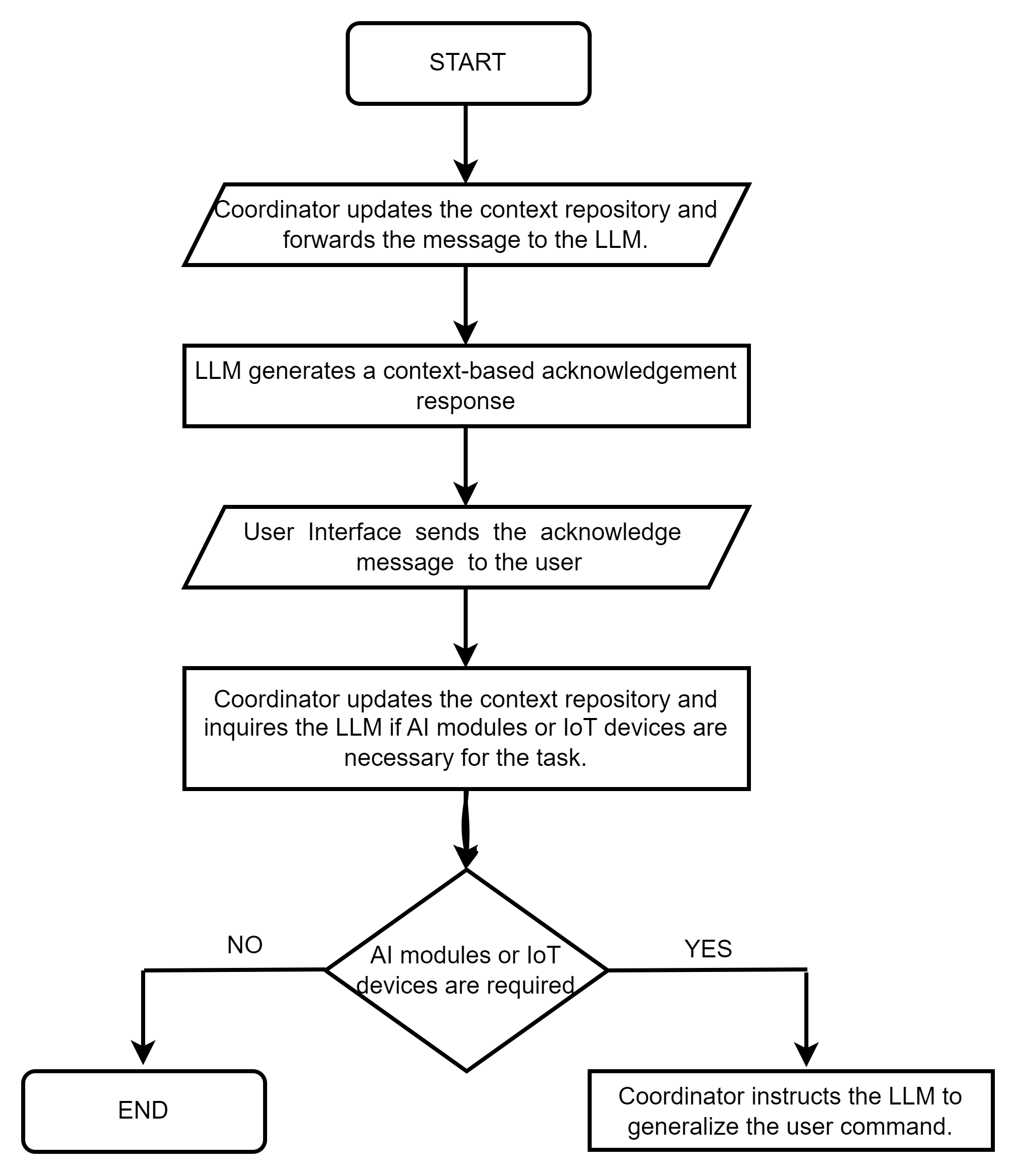
Data Flow Diagram

Slide 8
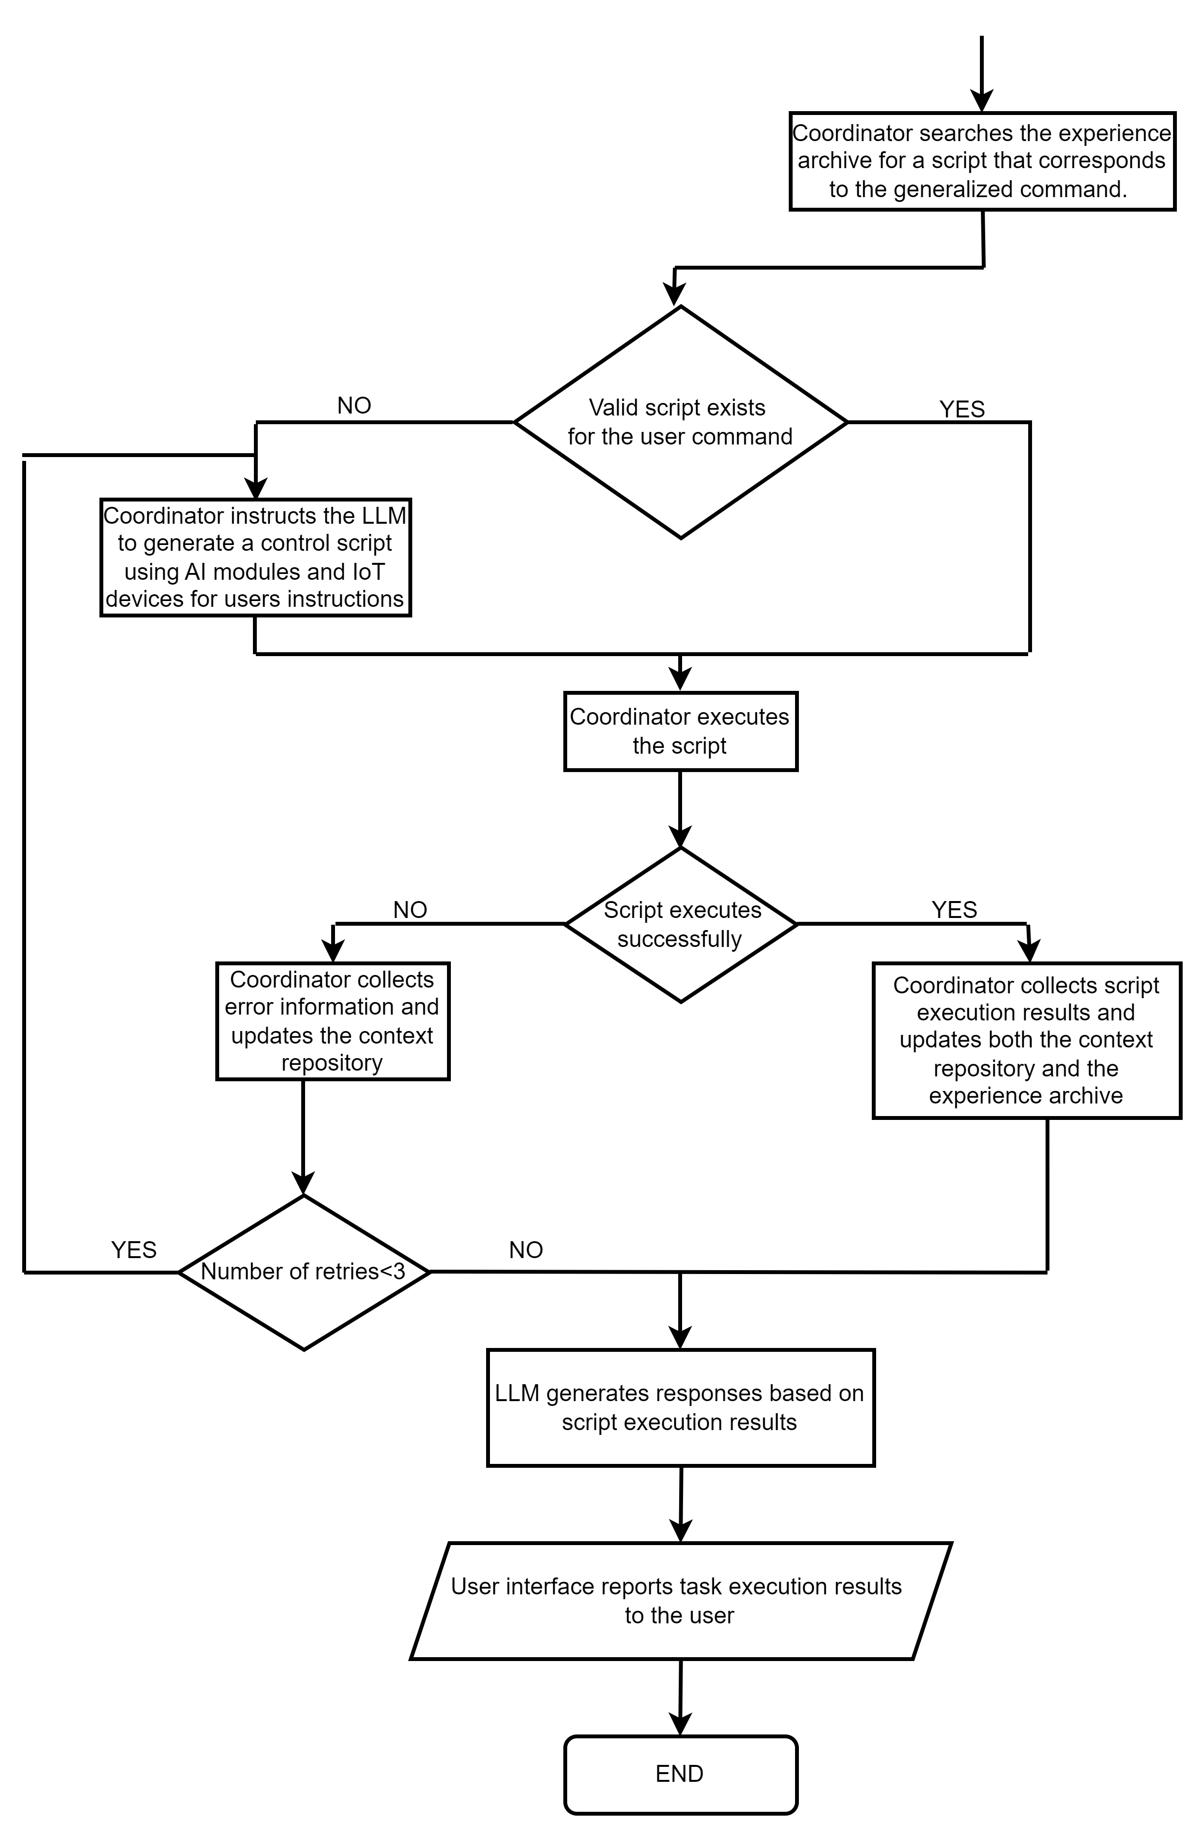

Slide 9
Stages / Modules
Research and Requirements Gathering:
Utilize sentiment analysis and topic modeling to understand user requirements and preferences within IoT contexts.
Employ data scraping and web crawling methods to gather relevant conversational data from forums, FAQs, and support channels.
Implement data preprocessing techniques such as tokenization, stemming, and lemmatization to prepare collected data for training.
Evaluate and select appropriate evaluation metrics such as BLEU, ROUGE, and perplexity to assess the performance of the chatbot.

Slide 10
Model Selection and Customization
Analyze the architecture and design of state-of-the-art language models such as GPT, BERT, and Transformer-XL to identify their strengths and weaknesses.
Employ transfer learning techniques such as fine-tuning and domain adaptation to customize pre-trained language models for IoT-specific use cases.
Implement techniques such as attention mechanisms, positional encoding, and multi-head self-attention to enhance the model's understanding of context and dependencies in conversational data.
Utilize techniques such as dropout regularization, layer normalization, and gradient clipping to prevent overfitting and improve the generalization capability of the model.

Slide 11
Training and Fine-Tuning
Utilize large-scale conversational datasets such as Reddit conversations, Twitter conversations, and customer support chats to train the generative AI model.
Employ distributed training techniques using frameworks such as TensorFlow or PyTorch to leverage multiple GPUs or TPUs for accelerated training.
Implement curriculum learning strategies to gradually expose the model to more complex conversational patterns and scenarios during training.
Explore techniques such as adversarial training and reinforcement learning to improve the robustness and stability of the chatbot's responses.

Slide 12
Integration with IoT Platforms
Develop RESTful APIs and GraphQL endpoints to expose the chatbot's functionality and services to IoT devices and applications.
Utilize message queuing systems such as Kafka or RabbitMQ to handle asynchronous communication and event-driven workflows between the chatbot and IoT platforms.
Implement authentication mechanisms such as OAuth 2.0 and JWT to secure the communication channels and authenticate users and devices.
Utilize industry-standard IoT protocols such as MQTT, CoAP, and AMQP to ensure interoperability and compatibility with a wide range of IoT devices and platforms.

Slide 13
Deployment and Evaluation
Containerize the chatbot application using Docker or Kubernetes to enable seamless deployment and scaling across cloud-based or on-premises environments.
Implement continuous integration and continuous deployment (CI/CD) pipelines using tools such as Jenkins or GitLab CI to automate the deployment and testing process.
Utilize A/B testing and experimentation techniques to evaluate the performance of different versions of the chatbot and optimize its conversational capabilities.
Monitor key performance indicators (KPIs) such as response time, throughput, and error rates using tools such as Prometheus or Grafana to ensure the chatbot meets the desired performance objectives.

Slide 14
Documentation and Knowledge Transfer
Create detailed technical documentation including API specifications, architecture diagrams, and deployment guides using tools such as Swagger or OpenAPI.
Provide comprehensive training materials and tutorials to onboard developers and stakeholders onto the chatbot platform, covering topics such as API usage, integration best practices, and troubleshooting techniques.
Establish a knowledge sharing platform such as a developer portal or community forum to foster collaboration, innovation, and continuous improvement within the chatbot development community.
Conduct regular knowledge transfer sessions and workshops to disseminate best practices, lessons learned, and emerging trends in conversational AI and IoT integration.

Slide 15
Testing
1. Functionality Testing
Objective: Ensure the chatbot performs all intended functions correctly.
Unit Test:
Test individual functions such as command recognition, response generation, and error handling.
Verify proper handling of edge cases and invalid inputs.
Integration Test:
Test interactions between the chatbot and IoT devices.
Ensure proper communication between the chatbot and backend systems via APIs.
End-to-End Test:
Simulate real user scenarios to ensure the chatbot performs as expected from start to finish.
Test typical use cases like turning devices on/off, setting timers, adjusting settings, etc.

Slide 16
2. Performance Testing
Objective: Ensure the chatbot performs well under expected and peak loads.
Load Testing:
Test the chatbot's response times and behavior under normal and peak loads.
Use tools like JMeter or Locust to simulate multiple concurrent users.
Stress Testing:
Determine the chatbot's breaking point by gradually increasing the load until it fails.
Identify performance bottlenecks and ensure graceful degradation.
3. Security Testing
Objective: Ensure the chatbot and IoT ecosystem are secure from threats and vulnerabilities.
Verify that only authenticated users and devices can access the chatbot.
Test the implementation of Bearer and JWT.
Ensure that data in transit and at rest is encrypted.

Slide 17
Conclusion
The development and deployment of a Generative AI Chatbot tailored for IoT applications enhancing user interaction within IoT ecosystems.
By integrating conversational AI with IoT platforms, we can provide real-time assistance, seamless communication, and optimized operational processes.
Our project with PiltiSmart Technology Solutions encompasses thorough research, meticulous model selection, robust training and fine-tuning, seamless integration, and comprehensive deployment strategies.
By addressing the growing need for intelligent assistance in IoT environments, we aim to improve user experiences, streamline operations, and contribute meaningfully to PiltiSmart's mission of leveraging innovative technologies for IoT optimization.
Together, we are paving the way for a more connected, efficient, and intelligent future.

Slide 18
Future Enhancement
Implement more sophisticated natural language understanding (NLU) techniques to improve the chatbot's ability to comprehend complex user queries and provide more accurate responses.
Expand the chatbot's capabilities to support multiple languages, enabling seamless interaction for a diverse, global user base.
Incorporate voice recognition and synthesis to enable hands-free interaction with IoT devices, enhancing accessibility and user convenience.

Slide 19
Bibliography and References
Hongwei Cui , Yuyang Du , Qun Yang , Yulin Shao, Soung Chang Liew, “LLMind: Orchestrating AI and IoT with LLM for Complex Task Execution”, 20 Feb 2024.
Stack Overflow, https://www.stackoverflow.com
Reddit, https://www.reddit.com
GitHub, https://www.github.com/zylon-ai/private-gpt
Hugging Face, https://www.huggingface.co
Python Documentation, https://www.python.org/doc
Medium, https://medium.com/@cpaggen/minimal-python-code-for-local-llm-inference-112782af509a
YouTube, https://www.youtube.com/watch?v=wjZofJX0v4M

Slide 20
Screenshots

Slide 21
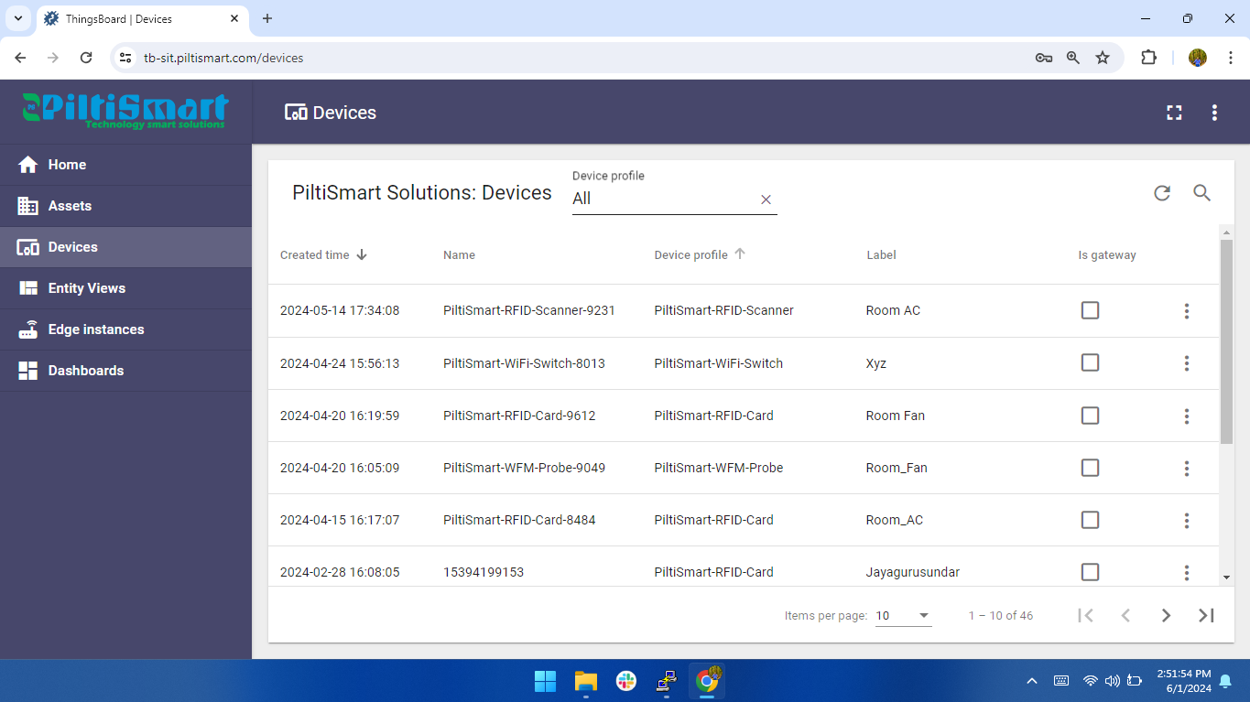
Integration With IoT Platforms

Slide 22
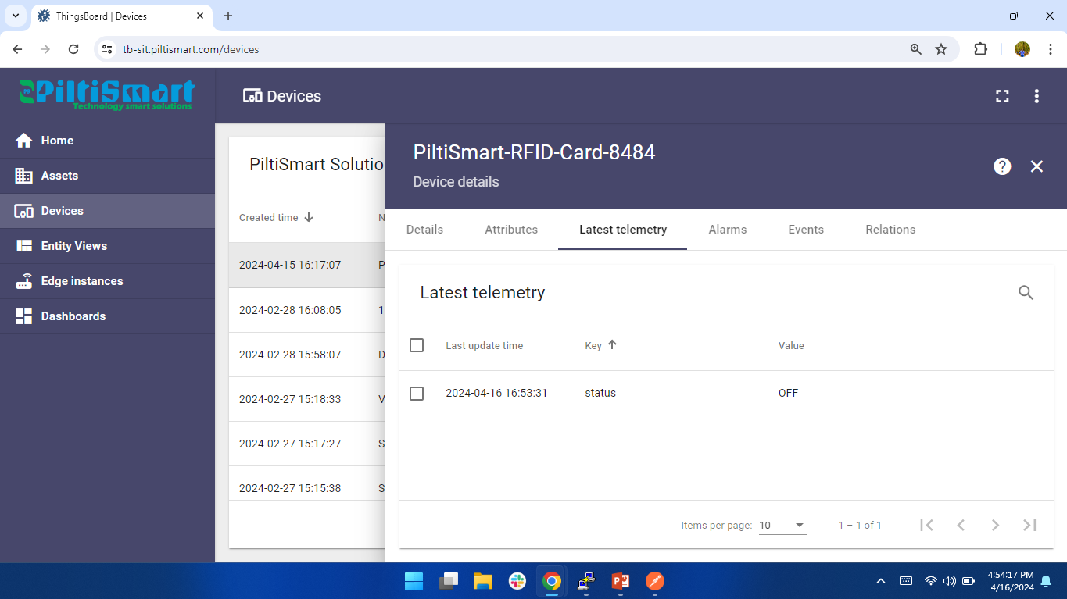
Integration With IoT Platforms

Slide 23
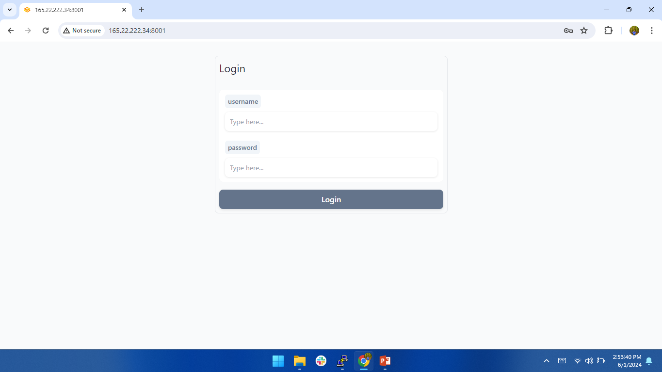
Chatbot Login

Slide 24
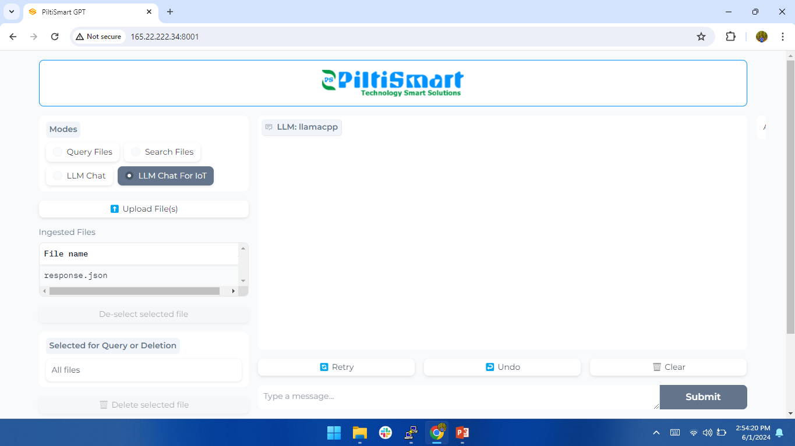
Request on a Chatbot

Slide 25
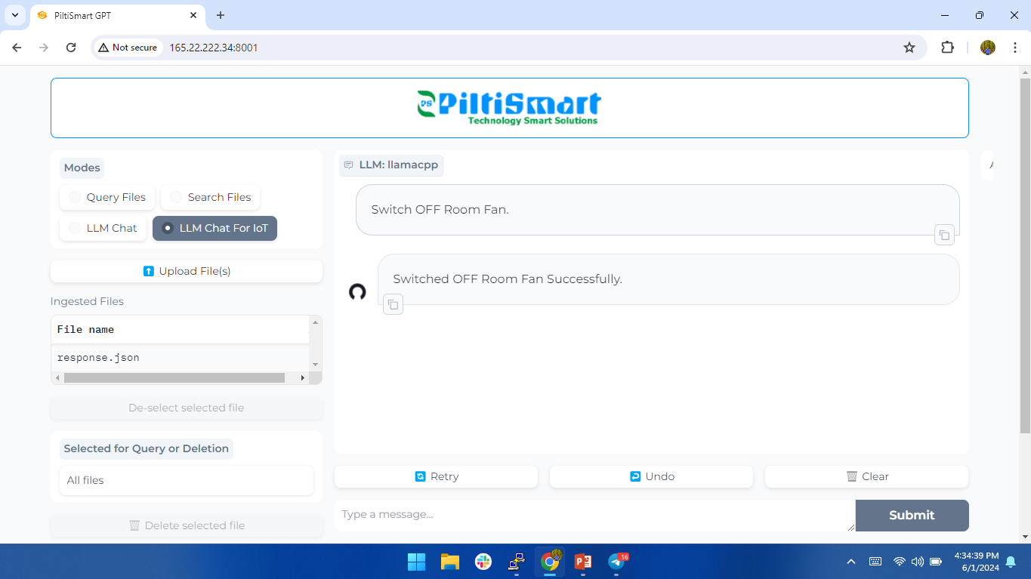
Response on a Chatbot

Slide 26
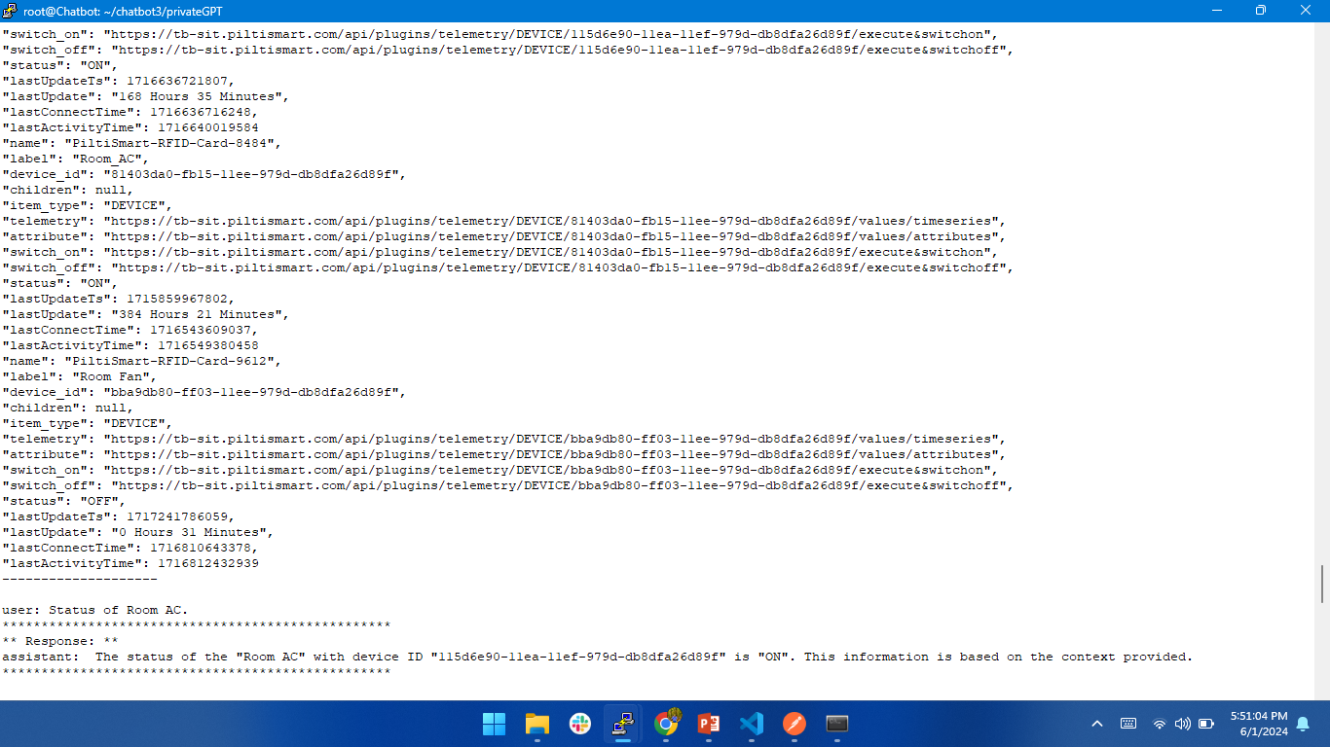
Response on a Chatbot

Slide 27
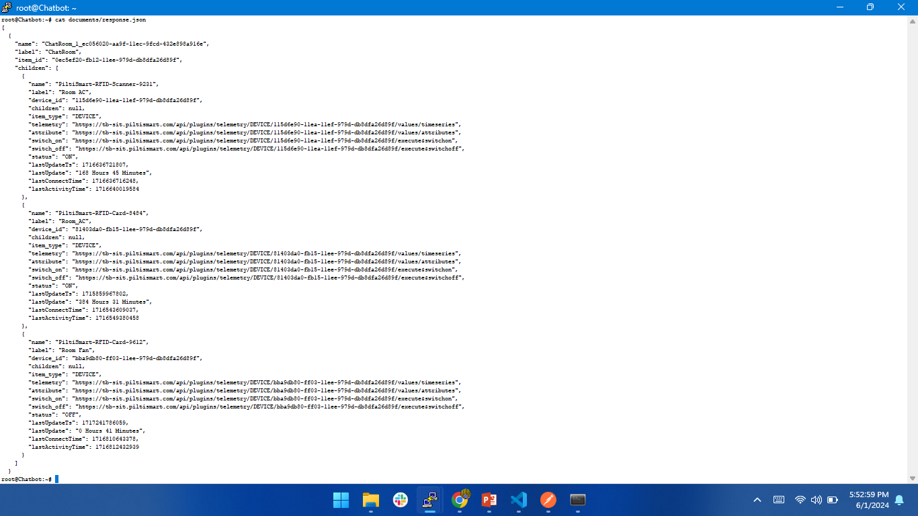
Response on a Chatbot

